Slide 1
Visualization of Sales dataset using power-bi

Slide 2
Description
In Power BI, visuals like line charts, card charts, bar charts, pie charts, and text boxes help bring the Superstore Sales Dataset to life. A line chart is ideal for showing sales or profit trends over time, making it perfect for time-series analysis. Card charts are used to highlight key metrics like total sales or total orders, giving stakeholders quick insights at a glance. Bar or column charts allow for easy comparison of sales or profit across categories such as Region, Segment, or Product. Pie charts can show percentage distribution, like sales share by category, though they're best used with fewer segments. Finally, text boxes are helpful for adding titles, notes, or explanations to guide users through your dashboard.
Charts Used
Line Chart
Bar Chart
Pie Chart
CARD
Text Box

Slide 3
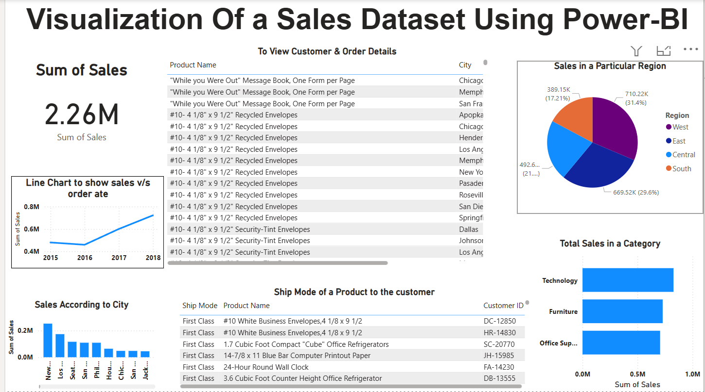
Output

Slide 4


